Slide 1
BD Internal Assessment
Question set -02

Slide 2
Part 1 - MongoDB

Slide 3
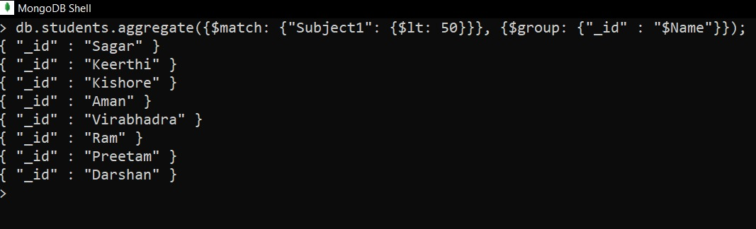
1. Demonstrate the usage of $match, $group, aggregate pipelines.

Slide 4
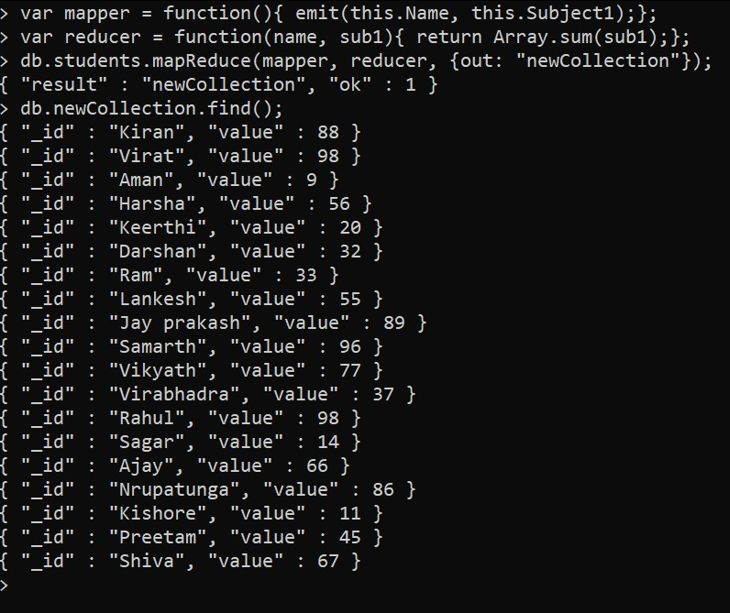
2. Demonstrate the Map-Reduce aggregate function on this dataset.

Slide 5
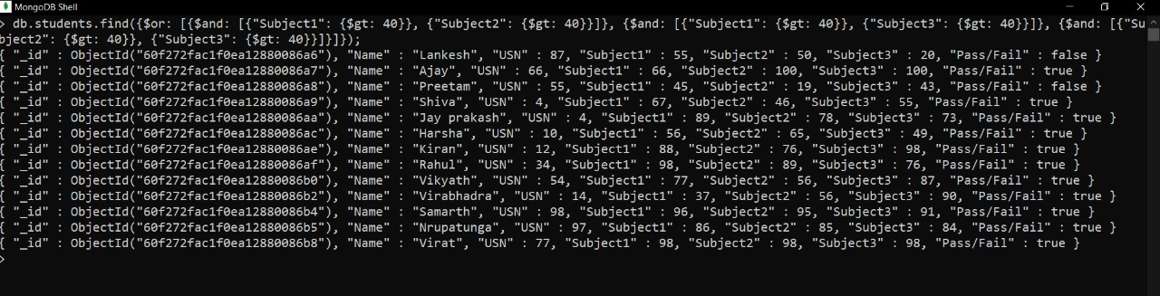
3. Count the number of students who had passed in at least 2 subjects.

Slide 6
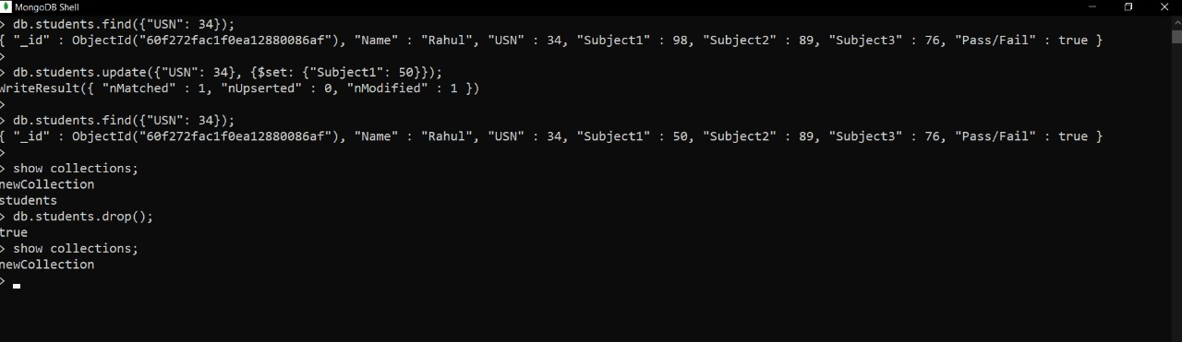
4. Demonstrate the Alter and Drop commands on this dataset.

Slide 7
Part 2- Hadoop

Slide 8
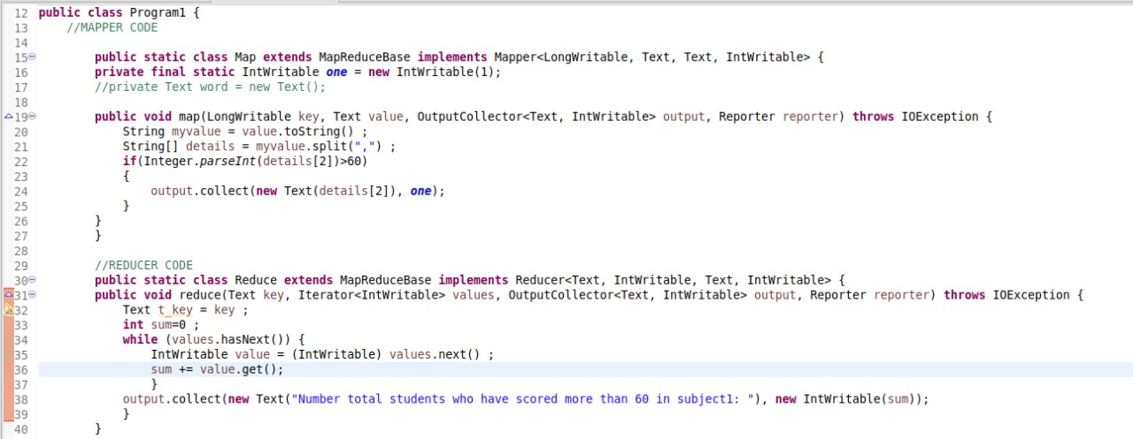
1. Total number of students who have scored more than 60 in subject 1.

Slide 9
1. Total number of students who have scored more than 60 in subject 1. Output:

Slide 10
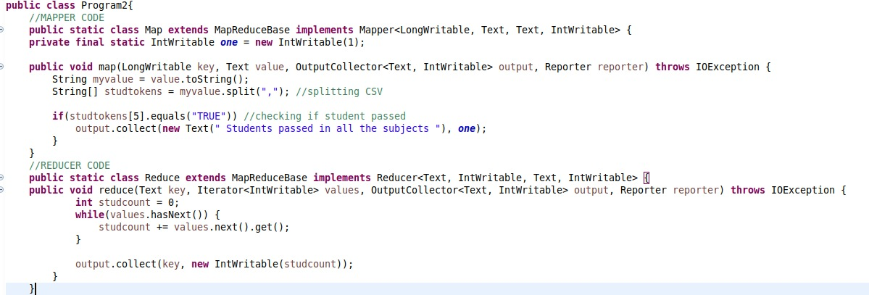
2. Total number of students who have passed in all subjects.

Slide 11
2. Total number of students who have passed in all subjects. Output:

Slide 12
LANKESHNAIK E C
1NT18IS087

